Slide 1


PRODUCT
CATALOG
SMC GRP
WATER TANK
LUCY
Manager
One-Stop GRP & Water Storage Solutions for Global Trade
WHATSAPP:+86 150 6612 7396
EMAIL:LUCY@SMCWATERTANK.COM
WAB: HTTPS://WWW.SMCWATERTANK.COM
Jinan Qianyan Technology Co., Ltd.
Factory-backed supply · Quality control · Export logistics · After-sales support
GLOBAL EXPORT SERVICE

Slide 2
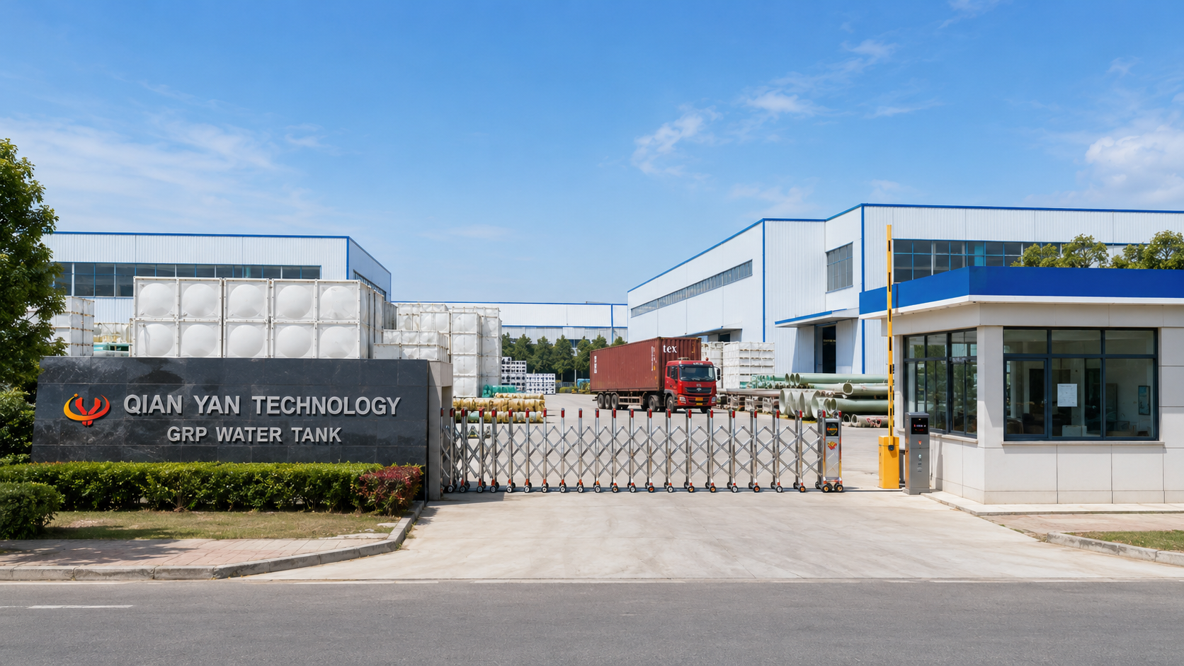
SMC GRP WATER TANK
Company Advantages at a Glance
Make your customer understand our value within the first page.
15+
1500+
120+
24H
Years Experience
Projects Served
Global Partners
After-Sales Response
Reliable Supply Chain
Factory-backed production resources and stable export order follow-up.
Strict Quality Control
Inspection follow-up from product selection to packing and delivery.
Global Trade Support
Quotation, documentation, container loading and logistics coordination.
Project-Based Service
Tank sizing, accessories, packaging and after-sales support for each project.
Jinan Qianyan Technology Co., Ltd. · GRP Water Tank & FRP Products Export Service
02

Slide 3
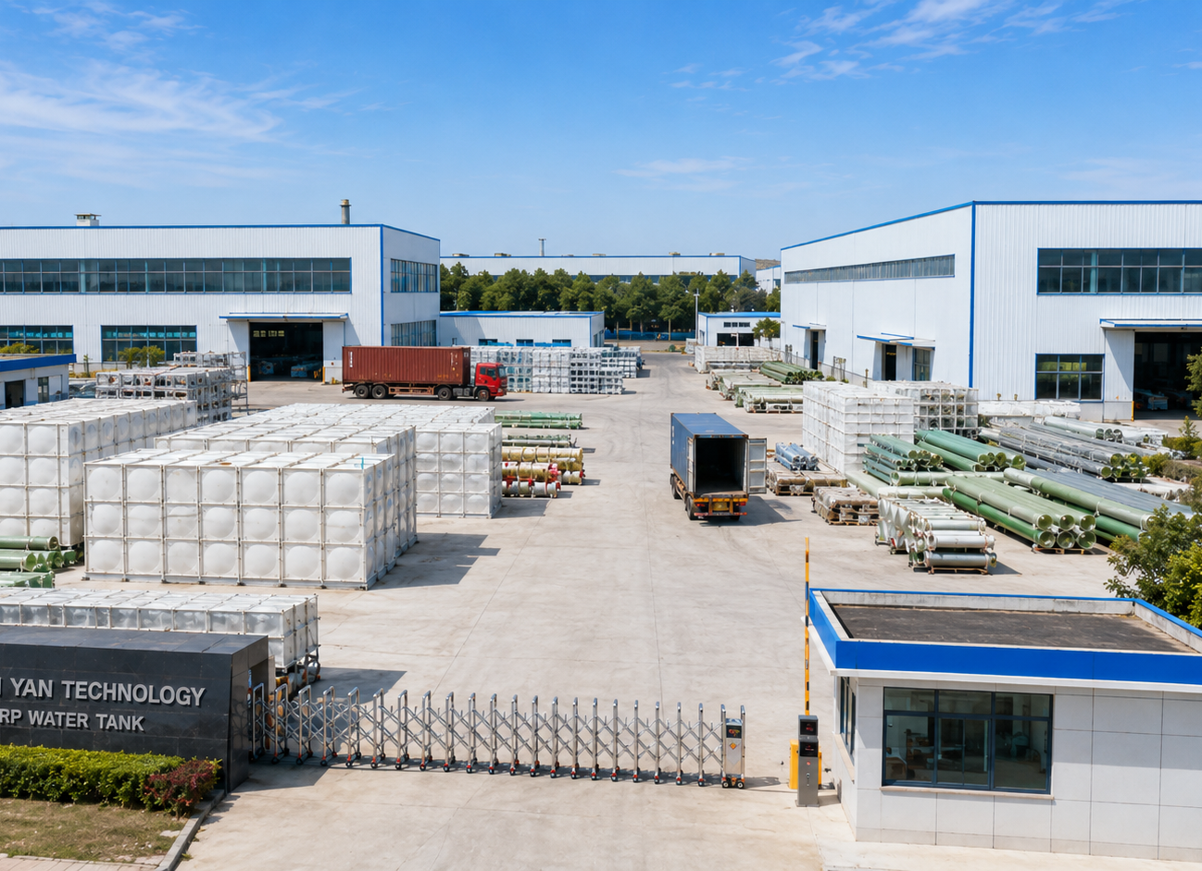
SMC GRP WATER TANK
Company Profile
Professional international trading company for GRP water tank and FRP products.
QIAN YAN focuses on international trade of GRP sectional water tanks and related water storage products. We provide professional product selection, reliable supply coordination, export packing, container loading and after-sales service for global customers.
Core Product Lines
• GRP / SMC sectional water tanks
• Stainless steel and galvanized water tanks
• Underground FRP tanks and FRP storage tanks
• FRP pipes, towers, grating and profiles
Our Positioning
One-stop export partner for water storage and FRP engineering products.
Jinan Qianyan Technology Co., Ltd. · GRP Water Tank & FRP Products Export Service
03

Slide 4
SMC GRP WATER TANK
Why Choose Us
Five advantages designed for distributors, contractors and project buyers.
01
Professional Product Knowledge
02
Quality-Oriented Supply
Tank structure, panel specification, accessories, installation and application guidance.
Strict follow-up during production, inspection, packaging and export loading.
03
Customized Project Solutions
04
Efficient Export Coordination
Size, capacity, panel thickness, accessories and packing can be matched to project needs.
Export documents, container loading plans and logistics coordination for overseas customers.
05
Responsible After-Sales Support
Installation guidance, use suggestions and timely problem support for every order.
A catalog built for global project cooperation
Jinan Qianyan Technology Co., Ltd. · GRP Water Tank & FRP Products Export Service
04

Slide 5
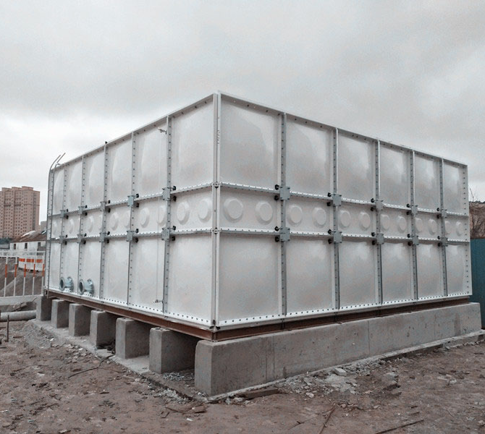
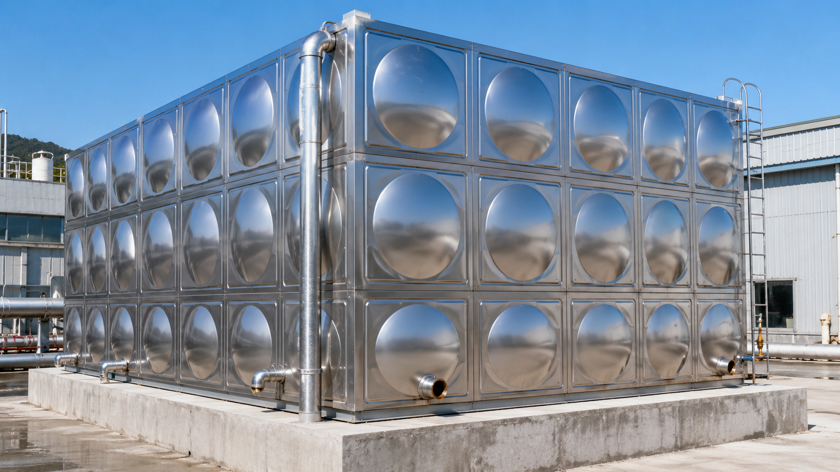
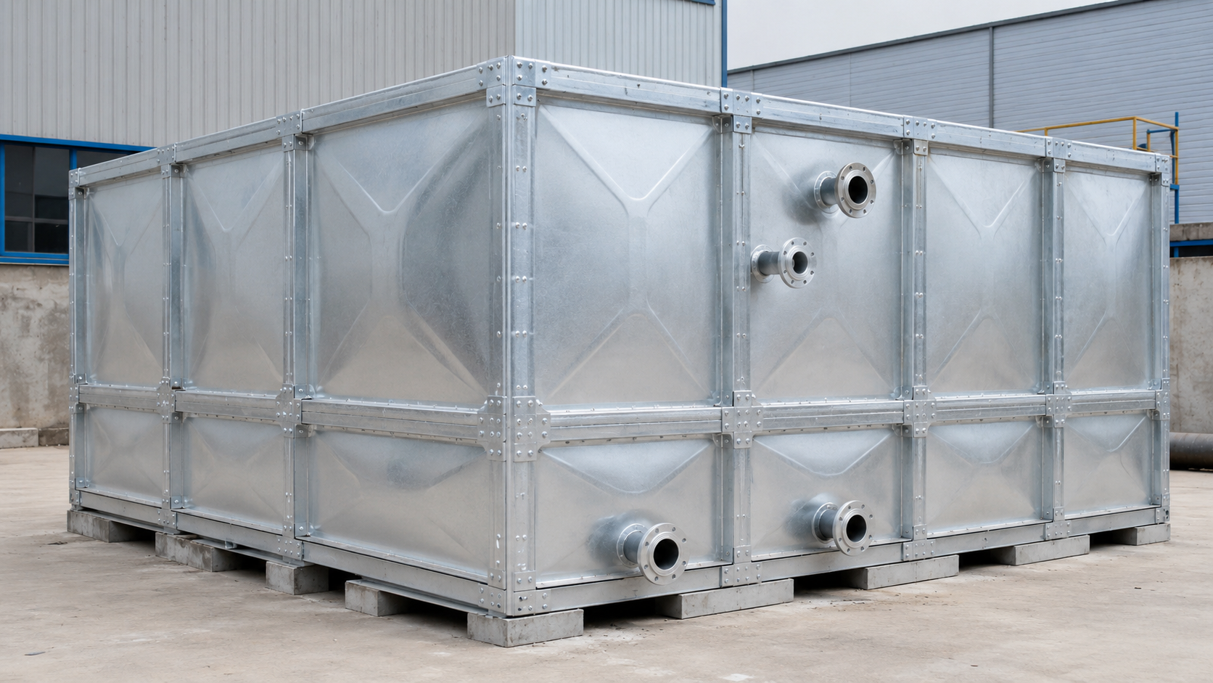
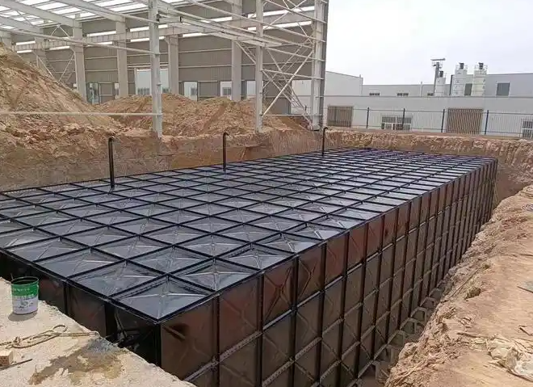
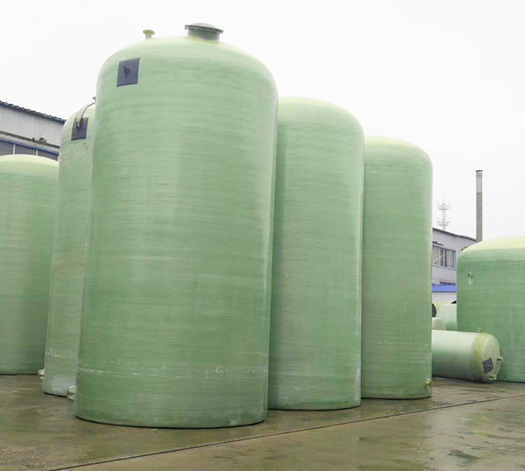
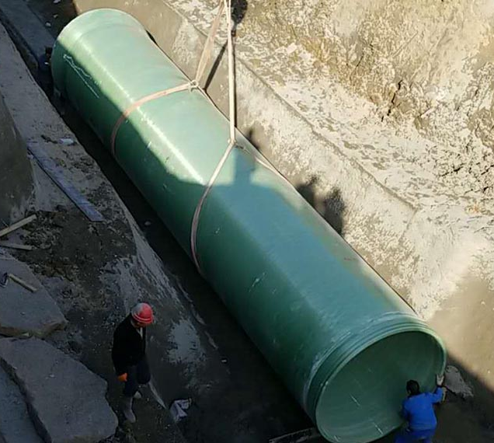
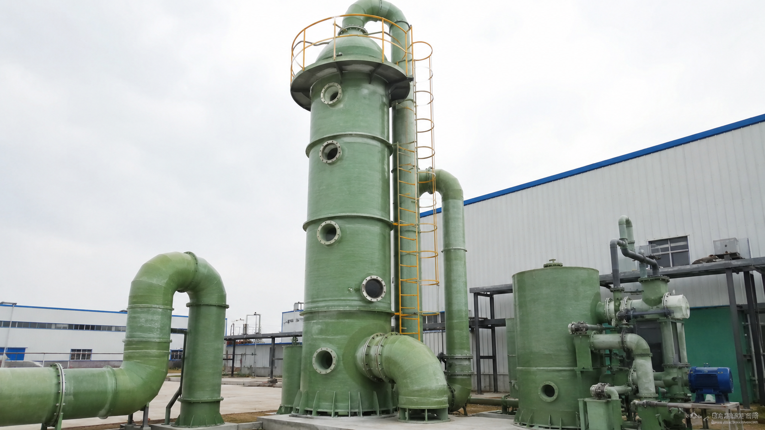
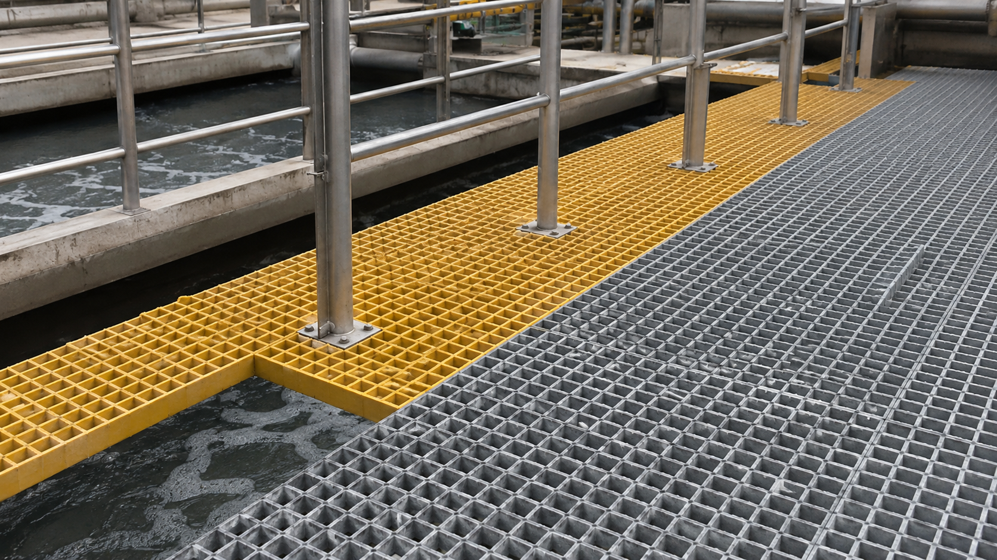
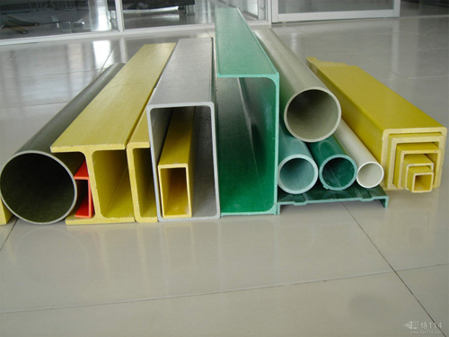
SMC GRP WATER TANK
Product Portfolio
Main product categories for water storage, construction, industrial and municipal projects.
01
SMC FRP Water Tank
02
Stainless Steel Water Tank
03
Galvanized Water Tank
Custom specs · Export packing · Project support
Custom specs · Export packing · Project support
Custom specs · Export packing · Project support
04
Buried Underground Water Tank
05
FRP Storage Tank
06
FRP Pipe / Piping
Custom specs · Export packing · Project support
Custom specs · Export packing · Project support
Custom specs · Export packing · Project support
07
FRP Distillation Tower
08
FRP Grating
09
FRP Profiles
Custom specs · Export packing · Project support
Custom specs · Export packing · Project support
Custom specs · Export packing · Project support
Jinan Qianyan Technology Co., Ltd. · GRP Water Tank & FRP Products Export Service
05

Slide 6
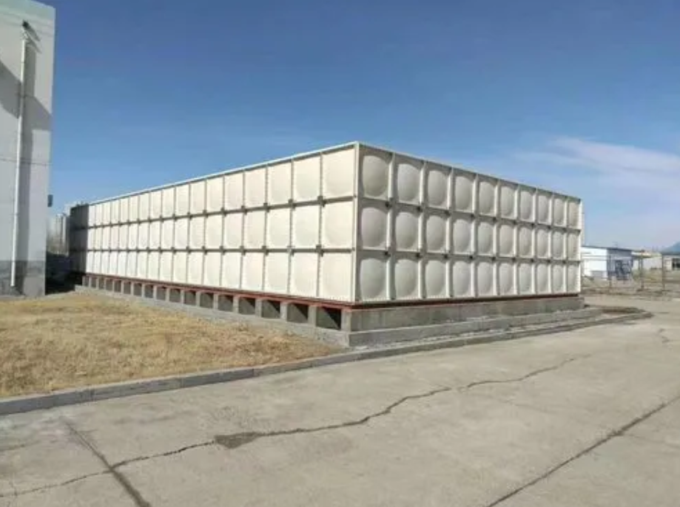
SMC GRP WATER TANK
SMC FRP Water Tank
Modular sectional tank for reliable water storage.
SMC / GRP sectional water tank is assembled by panels, sealing materials, bolts, internal supports and accessories. Suitable for large capacity and flexible site conditions.
Typical Specifications
Material
SMC / GRP / FRP panels with sealing strip and bolts
Panel size
1000×1000, 1000×500, 500×500, 1500×500 mm
Thickness
Approx. 4–16 mm, selected by tank height
Capacity
Project-based, commonly 1–1000 m³ or more
Accessories
Manhole, ladder, flanges, tie rods, seals, bolts
Custom specifications available
Export packing support
Project-based solution
Applications
Building water supply · Fire-fighting storage · Industrial projects
Jinan Qianyan Technology Co., Ltd. · GRP Water Tank & FRP Products Export Service
06

Slide 7
SMC GRP WATER TANK
Stainless Steel Water Tank
Clean and hygienic modular water storage.
Stainless steel water tanks are used for clean water storage, rooftop systems and engineering projects requiring a hygienic appearance and easy maintenance.
Typical Specifications
Material
SUS304 / SUS316 / SUS316L optional
Panel size
1000×1000, 1000×500, 500×500 mm
Thickness
Approx. 1–4 mm or project-based
Structure
Bolted or welded modular structure
Foundation
Concrete base, U-steel base or skid base
Custom specifications available
Export packing support
Project-based solution
Applications
Domestic water · Commercial buildings · Industrial facilities
Jinan Qianyan Technology Co., Ltd. · GRP Water Tank & FRP Products Export Service
07

Slide 8
SMC GRP WATER TANK
Galvanized Water Tank
Strong modular structure for engineering water storage.
Galvanized water tank systems are designed for stable project use with bolted modular panels, suitable for construction and temporary engineering storage.
Typical Specifications
Material
Hot-dip galvanized steel panels
Panel size
1000×1000, 1000×500, 500×500 mm
Thickness
Approx. 2–5 mm or project-based
Structure
Bolted panel system with sealing strip
Accessories
Ladder, manhole, flanges, tie rods, bolts
Custom specifications available
Export packing support
Project-based solution
Applications
Construction projects · Temporary storage · Engineering water systems
Jinan Qianyan Technology Co., Ltd. · GRP Water Tank & FRP Products Export Service
08

Slide 9
SMC GRP WATER TANK
Buried Underground Water Tank
Space-saving tank solution for underground installation.
Underground tanks help save ground space and are widely used for fire-fighting storage, rainwater collection and water treatment projects.
Typical Specifications
Material
FRP / GRP or steel-reinforced structure
Installation
Buried underground with project foundation design
Capacity
Customized according to project volume
Features
Space-saving, protected installation, flexible layout
Accessories
Manhole, inlet/outlet, vent, ladder optional
Custom specifications available
Export packing support
Project-based solution
Applications
Fire-fighting storage · Rainwater collection · Wastewater treatment
Jinan Qianyan Technology Co., Ltd. · GRP Water Tank & FRP Products Export Service
09

Slide 10
SMC GRP WATER TANK
FRP Storage Tank
Corrosion-resistant storage for industrial projects.
FRP storage tanks are suitable for corrosive liquids, environmental projects and process storage systems requiring lightweight anti-corrosion performance.
Typical Specifications
Material
FRP with resin system selected by media
Tank type
Vertical / horizontal / customized structure
Volume
Project-based customized volume
Features
Corrosion-resistant, lightweight, strong structure
Fittings
Flanges, manholes, ladders, nozzles optional
Custom specifications available
Export packing support
Project-based solution
Applications
Chemical industry · Environmental projects · Water treatment
Jinan Qianyan Technology Co., Ltd. · GRP Water Tank & FRP Products Export Service
10

Slide 11
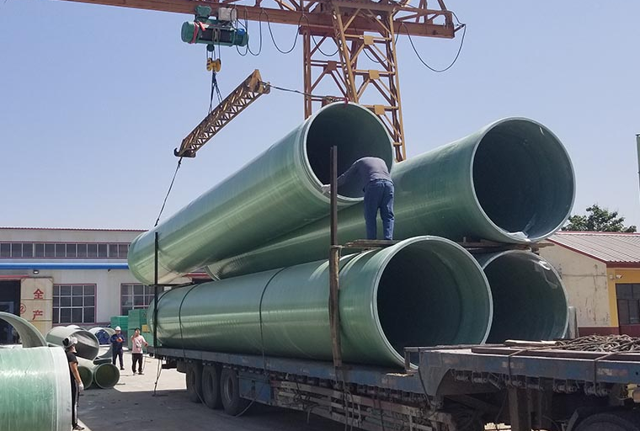
SMC GRP WATER TANK
FRP Pipe / FRP Piping
Lightweight and corrosion-resistant pipeline solution.
FRP pipe systems are used for water delivery, drainage, industrial pipelines and corrosion-resistant engineering systems.
Typical Specifications
Material
FRP / GRP with resin and fiber reinforcement
Diameter
Customized diameter range available
Length
Standard or project-based pipe length
Connection
Flange, socket, adhesive or coupling type
Features
Lightweight, corrosion resistant, long service life
Custom specifications available
Export packing support
Project-based solution
Applications
Water supply · Drainage · Chemical pipeline systems
Jinan Qianyan Technology Co., Ltd. · GRP Water Tank & FRP Products Export Service
11

Slide 12
SMC GRP WATER TANK
FRP Distillation Tower
FRP tower equipment for industrial process systems.
FRP towers and related equipment are used for corrosion-resistant industrial process, waste gas treatment and environmental protection systems.
Typical Specifications
Material
FRP, PP+FRP or PVC+FRP according to media
Design
Customized height, diameter and process configuration
Accessories
Packing, demister, spray system, manholes, flanges
Temperature
Selected by resin and process conditions
System
Matched piping and accessories available
Custom specifications available
Export packing support
Project-based solution
Applications
Chemical processing · Waste gas treatment · Environmental systems
Jinan Qianyan Technology Co., Ltd. · GRP Water Tank & FRP Products Export Service
12

Slide 13
SMC GRP WATER TANK
FRP Grating
Anti-slip platform and walkway solution.
FRP grating is commonly used for platforms, walkways and wet industrial environments due to anti-slip surface and corrosion resistance.
Typical Specifications
Material
Molded FRP / vinyl ester or polyester resin
Panel size
1220×3660 mm, 1000×3000 mm or custom
Thickness
25 mm, 38 mm, 50 mm common options
Mesh size
20×20, 38×38, 50×50 mm options
Surface
Concave, grit-top or anti-slip surface
Custom specifications available
Export packing support
Project-based solution
Applications
Industrial platforms · Walkways · Wastewater treatment plants
Jinan Qianyan Technology Co., Ltd. · GRP Water Tank & FRP Products Export Service
13

Slide 14
SMC GRP WATER TANK
FRP Profiles
Lightweight structural profiles for anti-corrosion projects.
FRP profiles include square tubes, round tubes, channels, angles and beams for anti-corrosion support structures and industrial platforms.
Typical Specifications
Process
Pultruded FRP structural profiles
Types
Square tube, round tube, C channel, angle, I beam
Size range
Reference sizes from small tubes to large beams
Length
Stock or customized project lengths
Features
Lightweight, corrosion resistant, electrically insulating
Custom specifications available
Export packing support
Project-based solution
Applications
Industrial platforms · Support frames · Anti-corrosion structures
Jinan Qianyan Technology Co., Ltd. · GRP Water Tank & FRP Products Export Service
14

Slide 15
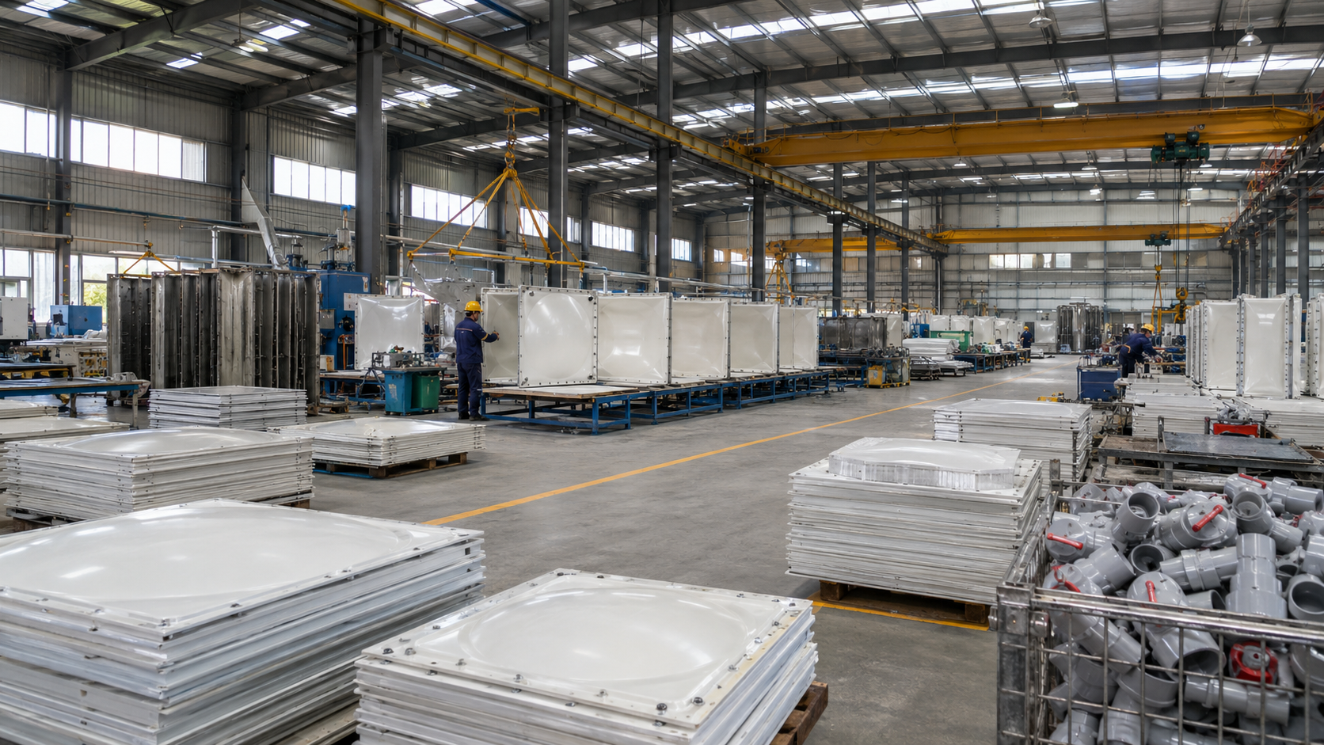
SMC GRP WATER TANK
Customization & Project Support
From inquiry to delivery, we help customers complete GRP water tank projects efficiently.
01
Tank Specification
Size · Capacity · Panel thickness
02
Accessory Matching
Flanges · Bolts · Seals · Ladders
03
Export Packing
Pallets · Bundling · Wooden cases
04
Project Documents
Quotation · Loading plan · Installation guidance
Full support from product selection to packing, loading, delivery and after-sales service.
Jinan Qianyan Technology Co., Ltd. · GRP Water Tank & FRP Products Export Service
15

Slide 16
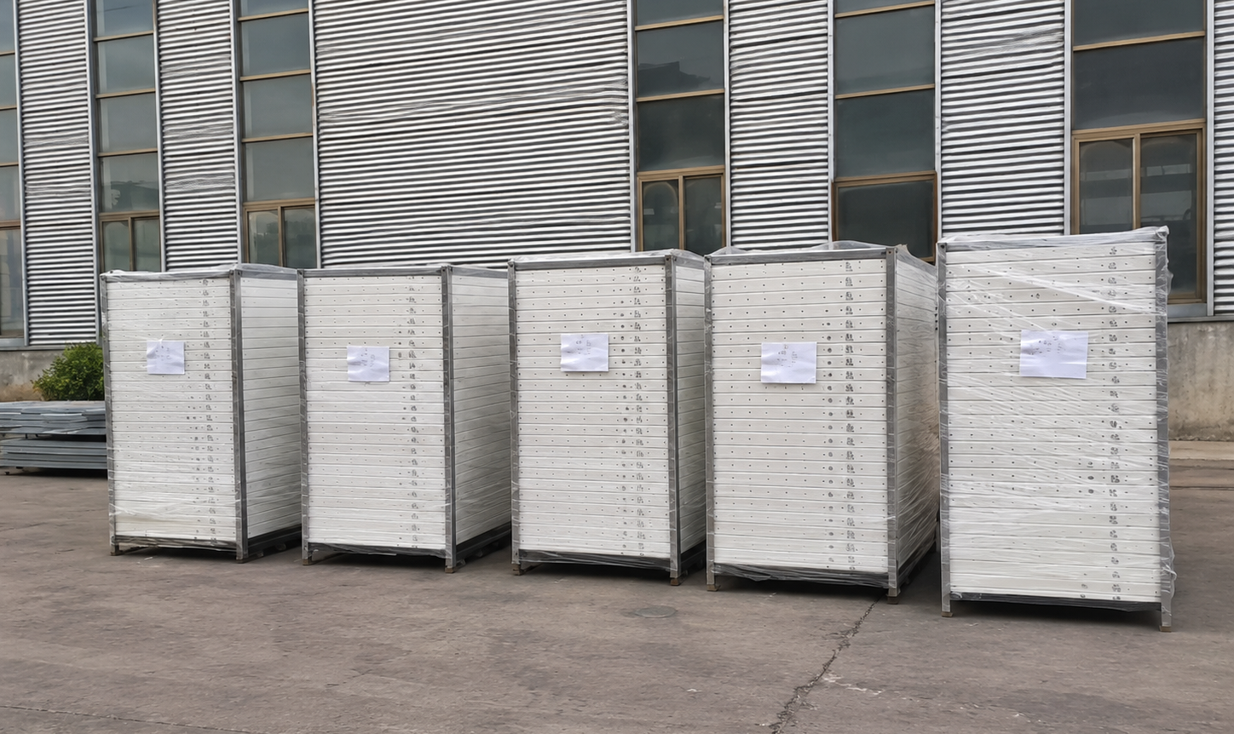
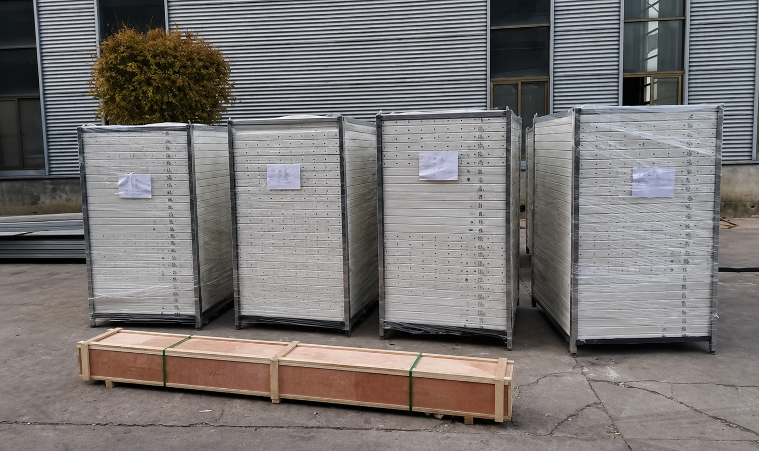
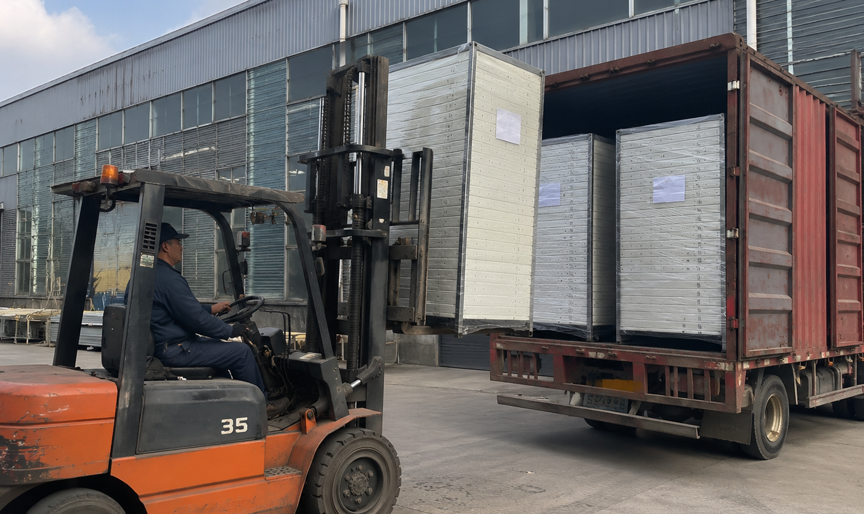
SMC GRP WATER TANK
Packaging & International Logistics
Heavy industrial products need safe packing and professional container loading plans.
Packed Tank Panels
Accessory Wooden Case
Container Loading
Stacked and protected for export shipment.
Long wooden box for fittings and accessories.
Forklift loading for heavy panel packages.
Export documents · Protective packing · 20ft / 40ft container planning · Shipment coordination
Jinan Qianyan Technology Co., Ltd. · GRP Water Tank & FRP Products Export Service
16

Slide 17

SMC GRP WATER TANK
Cooperation Models
Flexible cooperation for distributors, project buyers and regional partners.
Project-Based Procurement
Full Container Order
Distributor Cooperation
• Solution support
• Bulk shipment
• Long-term price support
• Technical selection
• 20ft / 40ft container
• Marketing materials
• Quotation support
• Lower logistics cost
• Regional market growth
• Export packing
• Stable supply
• Product training
• Loading coordination
• Order follow-up
• Priority order service
• After-sales guidance
• Regular procurement
• Partner development
Jinan Qianyan Technology Co., Ltd. · GRP Water Tank & FRP Products Export Service
17

Slide 18
Thank You
We look forward to building long-term cooperation with you.
Contact Information
Name: LUCY
WhatsApp: +86 150 6612 7396 | Email: LUCY@SMCWATERTANK.COM
Website: www.smcwatertank.com | Address: Jinan,Shandong, China
Quality Water Storage · Serving the World

